Slide 1
A Semantic Approach to Retrieving, Linking and Integrating Heterogeneous Geospatial Data
Ying Zhang
North China Electric Power University
dearzppzpp@gmail.com
Yao-Yi Chiang, Pedro Szekely, Craig A. Knoblock
Information Sciences Institute, University of Southern California
{yaoyichi, pszekely, knoblock}@isi.edu

Slide 2
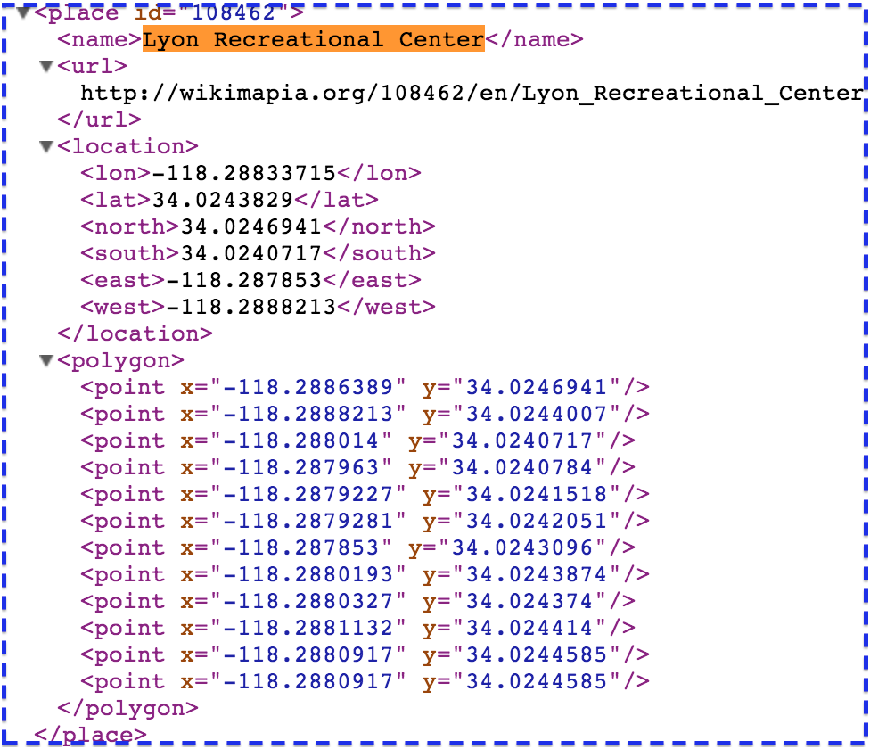
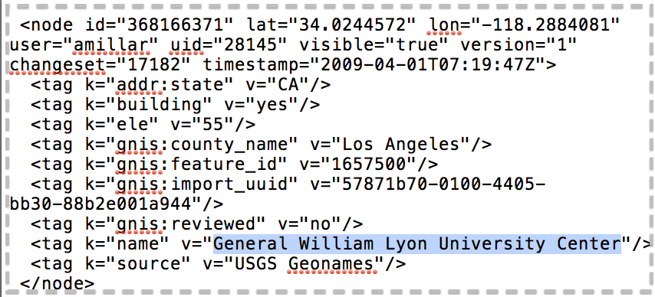
The Problem
The ability of end-users to retrieve, combine and integrate geospatial data is limited.
Different data structure
Different information for the same entity
Different geospatial data values (such as latitude, longitude, etc)
The Same Entity
From ：Wikimapia
From ：OpenStreetMap

Slide 3
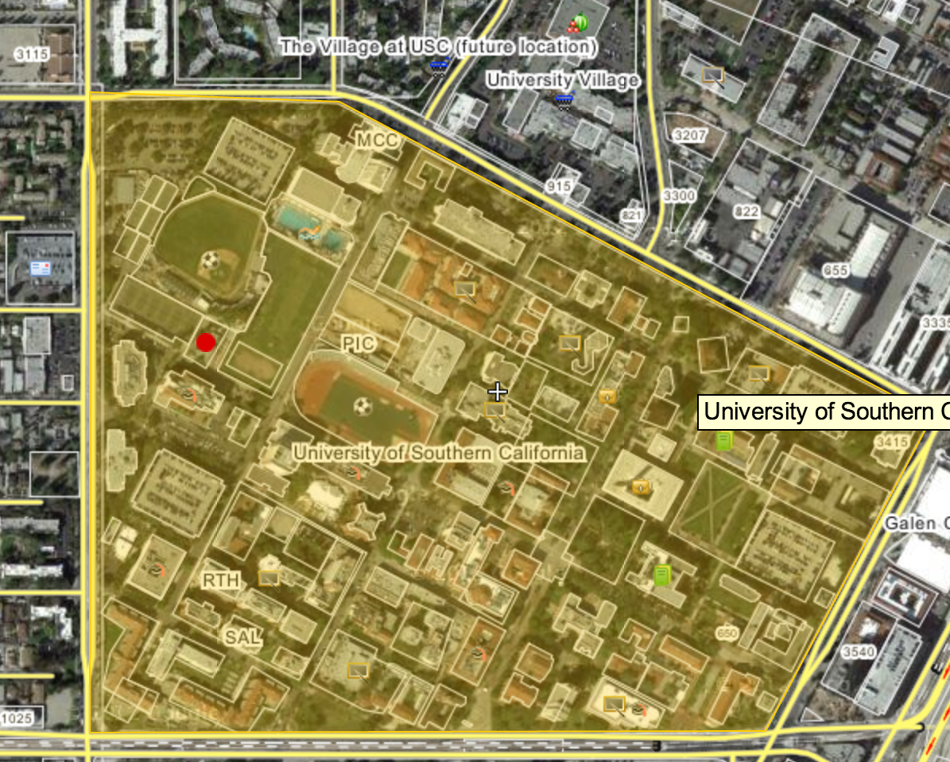
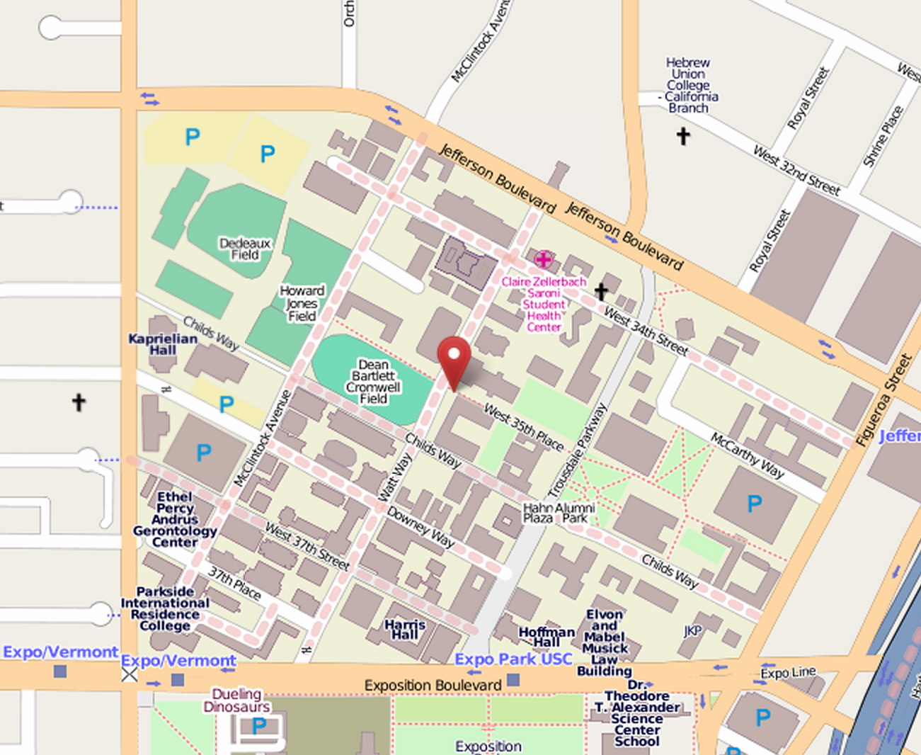
Motivation Example
Different sources have different information for the related entities

Slide 4
Overview

Slide 5
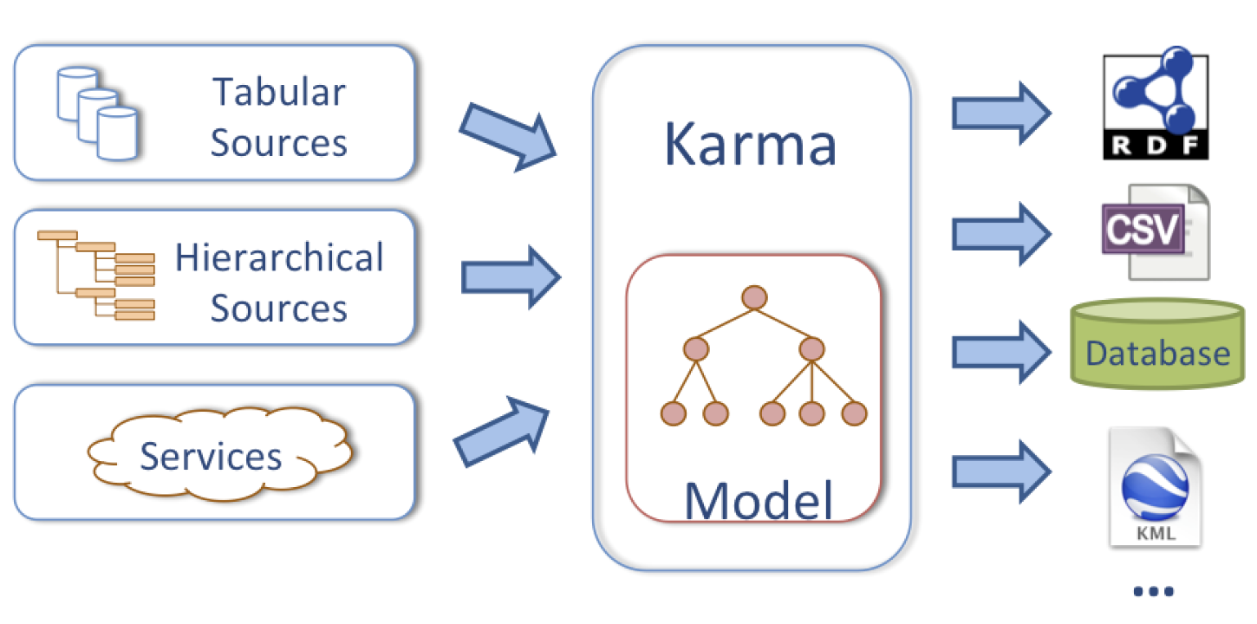
Karma
Interactive tool for rapidly extracting, cleaning, transforming, integrating and publishing data
[Knoblock, Szekely, et al. Semi-automatically mapping structured sources into the semantic web. ISWC 2012]

Slide 6
Outline
Model the Geospatial Data
Geospatial Data Linking
Geospatial Data Integration
Conclusion and Future work

Slide 7
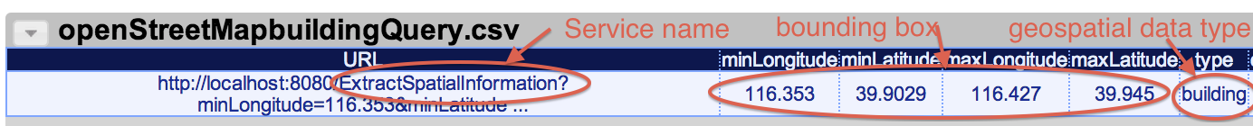
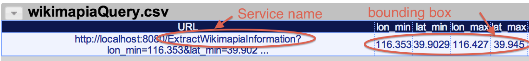
Model the Geospatial Data
Extract the geospatial data
Encapsulate the retrieval algorithms as Web services
Embed all the inputs in a URL

Slide 8
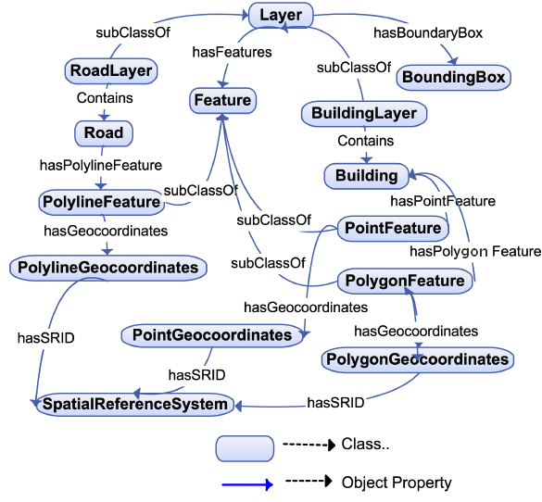
Model the Geospatial Data
Map the extracted geospatial data to RDF
Build a generic geospatial ontology for aligning the extracted data

Slide 9
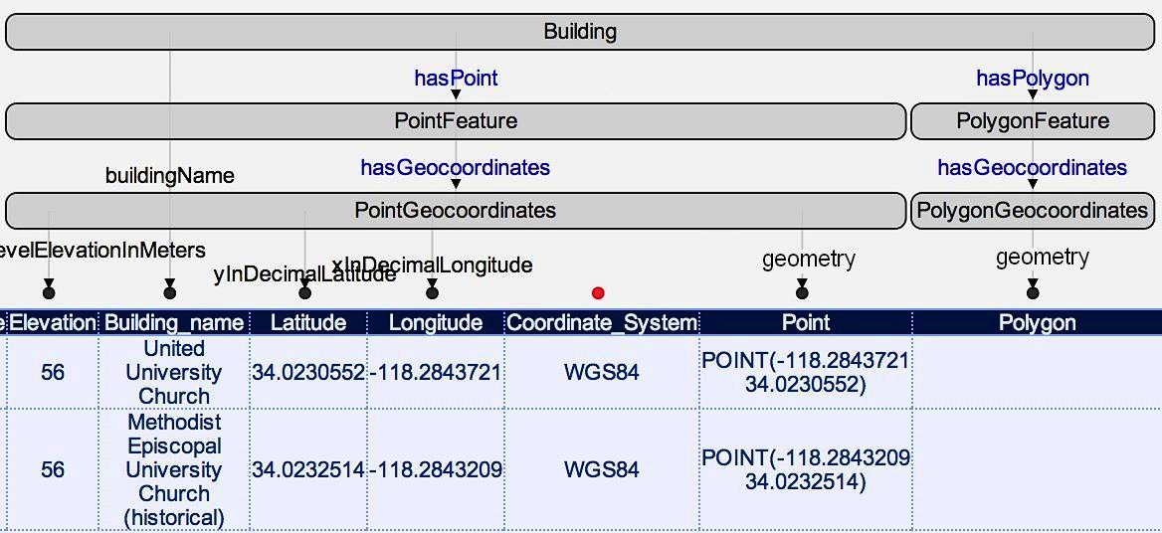
Model the Geospatial Data
Map the extracted geospatial data to RDF
Model the extracted geospatial data by mapping them to RDF data with Karma

Slide 10
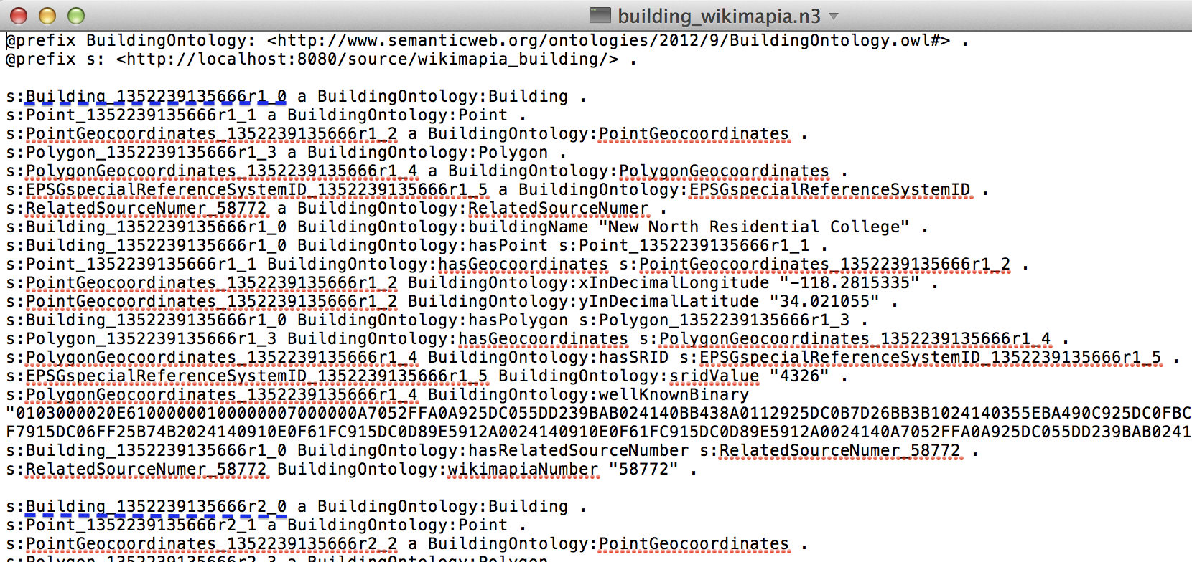
Model the Geospatial Data
Map the extracted geospatial data to RDF
The generated N3 file

Slide 11
Model the Geospatial Data
Map the extracted geospatial data to RDF
Building scenario visualized on Google Earth

Slide 12
Outline
Model the Geospatial Data
Geospatial Data Linking
Geospatial Data Integration
Conclusion and Future work

Slide 13
Geospatial Data Linking
Linking by the specific geospatial relationships
Geospatial relationships are very useful for linking
Relationships often cannot be determined by just comparing the values such as name
Distance ⬅ executeQuery(“Select ST_Distance(ST_Geography FromText(SRID=4326,s₁.getLocation),ST_GeographyFromText(SRID=4326,s₂.getLocation))”)
isContained ⬅ executeQuery(“Select ST_Contains (ST_ GeographyFromText(s₁.getLocation),ST_GeographyFromText(s₂.getLocation))”)
isOverlap ⬅ executeQuery(“Select ST_Overlaps(ST_Geography FromText (s₁.getLocation), ST_GeographyFromText (s₂.getLocation))”)

Slide 14
Geospatial Data Linking
Polygon-to-Polygon:
if (isContained=true){ similarity ⬅ 1.0; }
else if((isOverlap=true)) { similarity⬅ ; }
else { similarity ⬅ ε; }
Polygon-to-Point/Point-to-Point:
{ similarity⬅ ; }
Linking Result:
if (similarity>threshold){
linkedPair.add(s₁,s₂);
}

Slide 15
Geospatial Data Linking
Linking results illustration

Slide 16
Outline
Model the Geospatial Data
Geospatial Data Linking
Geospatial Data Integration
Conclusion and Future work

Slide 17
Geospatial Data Integration
Based on the record linkages, use SPARQL queries to eliminate data redundancy and combine complementary properties for integration
sparqlS₁ : general query
Select discinct ?uri
Where{
?uri owl:sameAs ?u.
?uri a BuildingOntology:Building
}

Slide 18
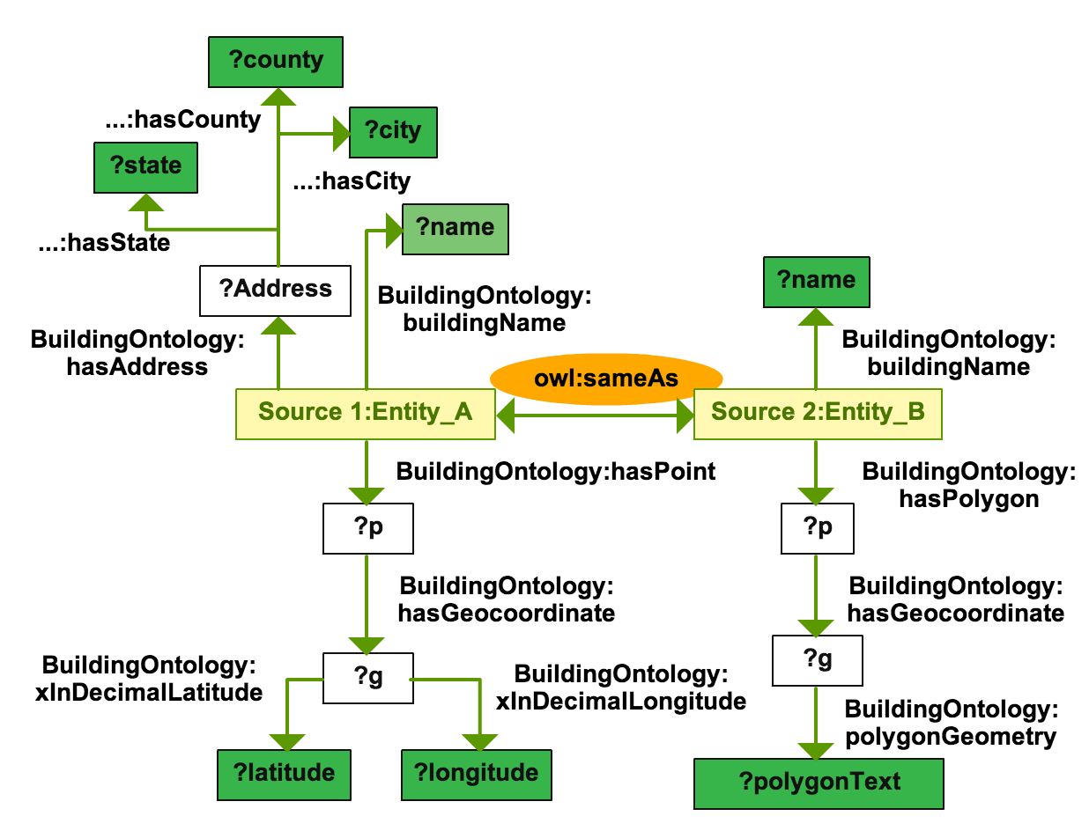
Geospatial Data Integration

Slide 19
Geospatial Data Integration
Display integration results

Slide 20
Outline
Model the Geospatial Data
Geospatial Data Linking
Geospatial Data Integration
Conclusion and Future work

Slide 21
Conclusion
We were able to empower end-users to rapidly extract, link and integrate geospatial data by means of both semantic techniques and spatial characteristics
Encapsulate the retrieval algorithms as Web services
Align the extracted geospatial data by mapping them to a generic geospatial ontology
Link similar entities from different sources based on the matched similarity
Use SPARQL queries to eliminate data redundancy and combine complementary properties

Slide 22
Future Work
Experimental comparison with other approaches
Using additional attributes to optimize the geospatial data linking and integration process to improve the integration results

Slide 23
Thank you!

